Slide 1

Neural Networks and Deep Learning History
23CSE473 Neural Networks and Deep Learning 3- 0- 0- 3

Slide 2
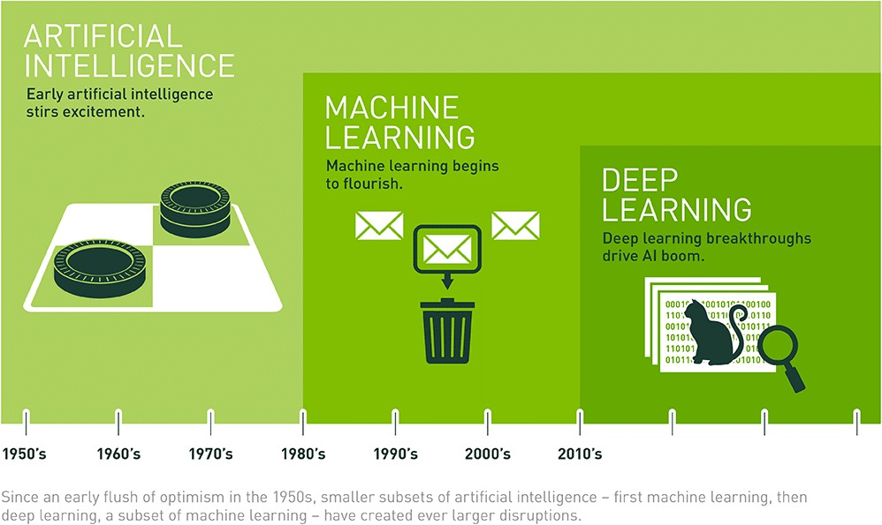
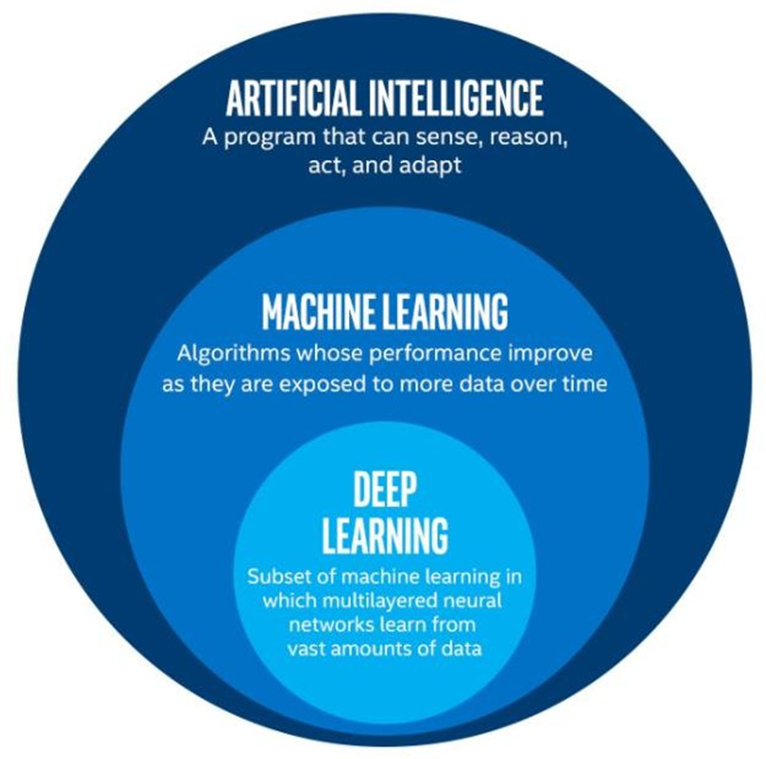
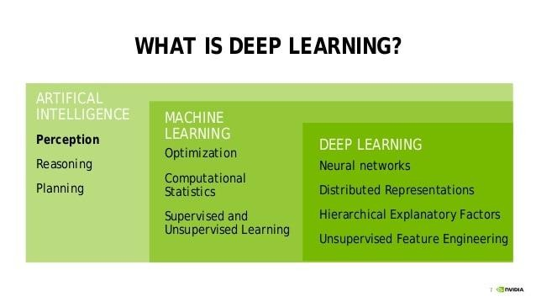

Slide 3
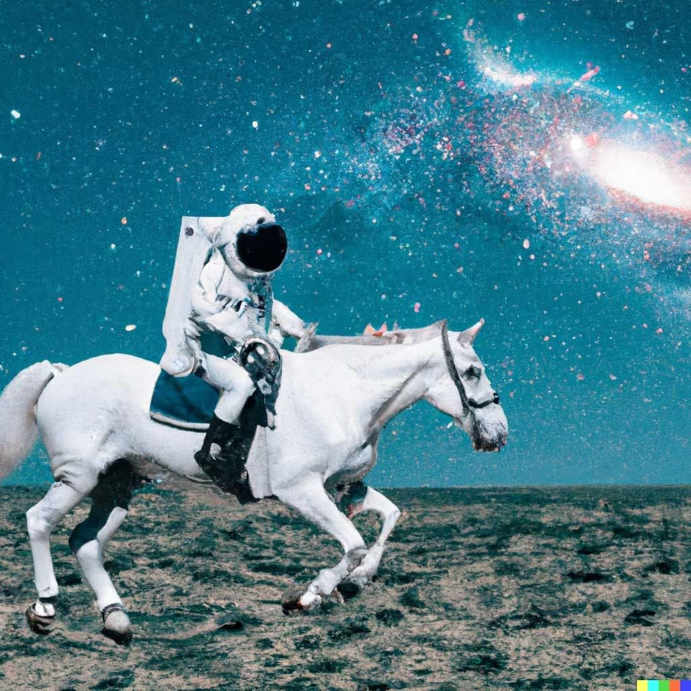
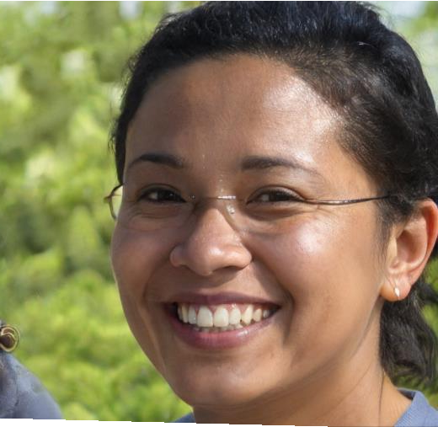
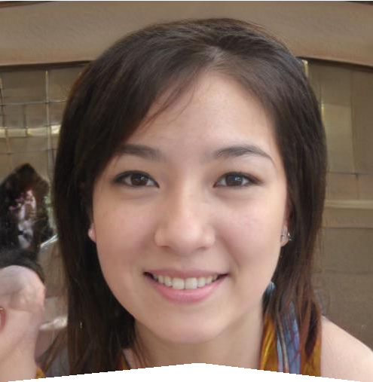
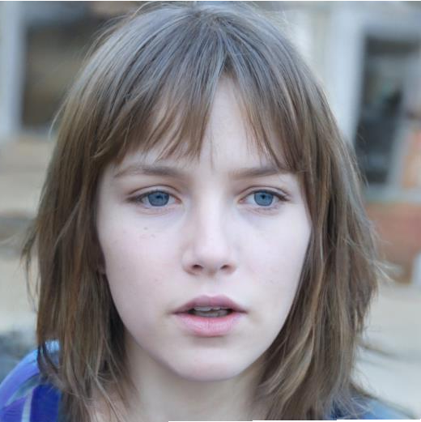
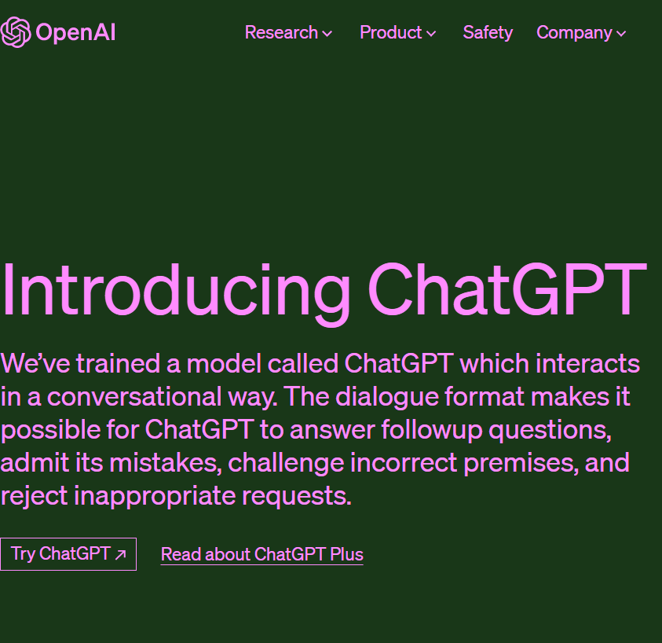
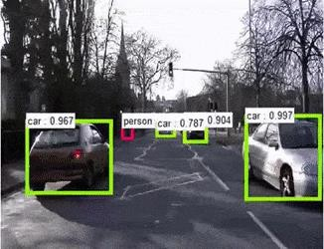
DeepFake
Output from DALL-E : OPEN AI
An astronaut riding a horse in photorealistic style.
https://thispersondoesnotexist.com/
DALL-E 2 can create original, realistic images and art from a text description. It can combine concepts, attribute. Latest is DALL-E 3

Slide 4
Latest AI Developments – August 2025
Advanced AI Models
GPT‑4.5 by OpenAI: Faster, more capable; GPT‑5 coming soon
Grok‑3 by xAI (Elon Musk): Strong reasoning, “Big Brain” mode
Mistral Medium 3: High performance open-source model
Manus AI: Fully autonomous digital agents in real-world tasks
Infrastructure & Industry Push
Massive AI investments:
Amazon: $100B, Google: $85B, Meta: $64B+
Meta building “Manhattan-sized” AI data centers
Apple & GitHub: AI is the future of all software and devices
⚖️ AI Policies & Safety
Global AI Safety Summit: 58 countries signed “Sustainable AI” pact
India’s BharatGen Mission: Focus on multilingual, inclusive AI
Rajasthan AI Policy 2025: ₹1000 Cr investment in AI innovation
🏥 Real‑World Applications
Healthcare: AI used in diagnostics, clinical notes, and surgery
Developers: Shift from coding to overseeing AI workflows
Education: AI tutors and personalized learning at scale
Key Trends
78% of companies now use AI (up from 55% in 2023)
Global GenAI funding: $33.9 billion in 2024
Focus on Explainable AI, reasoning, and safety alignment

Slide 5
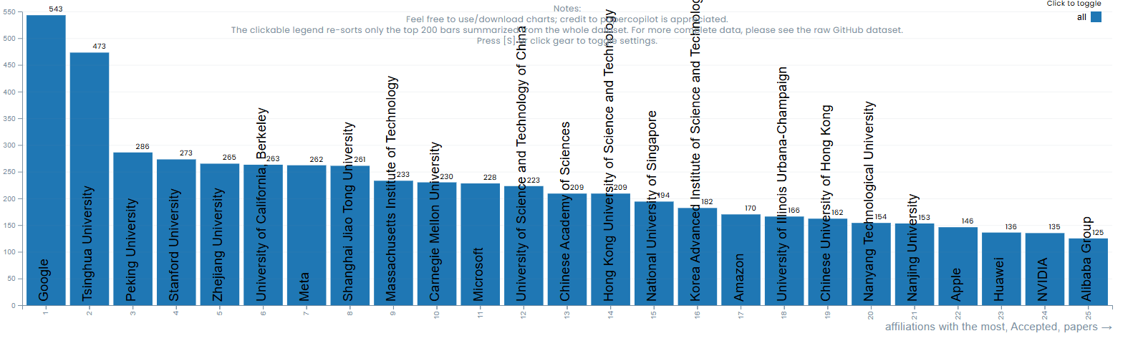
ICML 2025
The International Conference on Machine Learning (ICML) is the premier gathering of professionals dedicated to the advancement of the branch of artificial intelligence known as machine learning.

Slide 6
Deep Learning –
History
Introduction

Slide 7
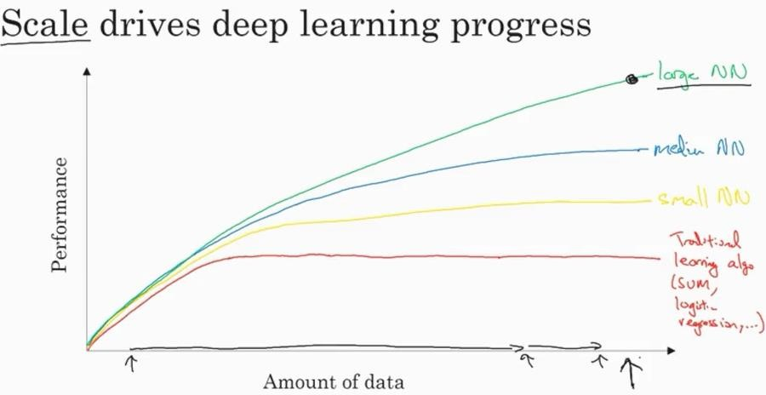

Artificial Intelligence Paradigmshift!-
Machine Learning → Deep Learning?
Promising results if trained with lot of data!

Slide 8
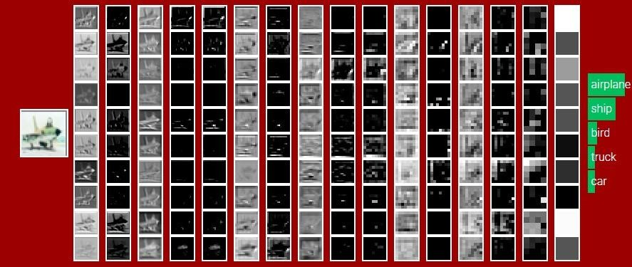
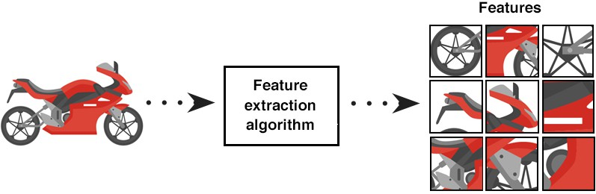
Deep Learning
Deep Learning (DL) uses layers of algorithms to process data, understand human speech, and visually recognize objects.

Slide 9
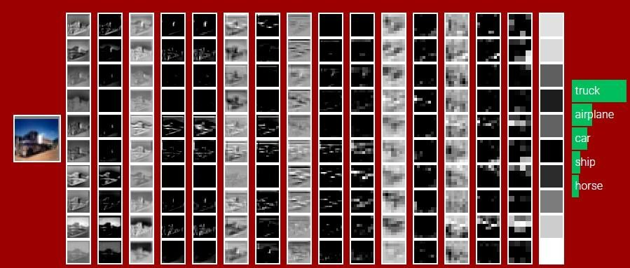
Deep Learning-
Information is passed through each layer, with the output of the previous layer providing input for the next layer. The first layer in a network is called the input layer, while the last is called an output layer. All the layers between the two are referred to as hidden layers

Slide 10
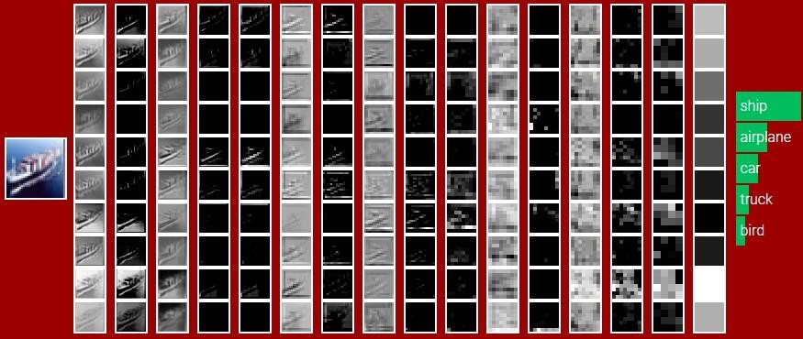
Deep Learning-
Information is passed through each layer, with the output of the previous layer providing input for the next layer. The first layer in a network is called the input layer, while the last is called an output layer. All the layers between the two are referred to as hidden layers

Slide 11
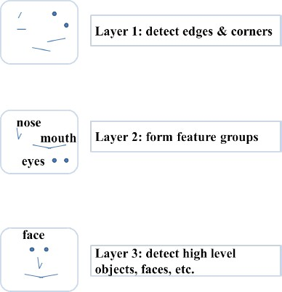
Neurons are arranged in a hierarchical fashion
Neurons are arranged in a hierarchical fashion and each layer has its own role and responsibility.
To detect a face, the brain could be relying on the entire network
and not on a single layer.
Courtesy :Sample illustration of hierarchical processing.
Credits: Mitesh M. Khapra’s lecture slides

Slide 13
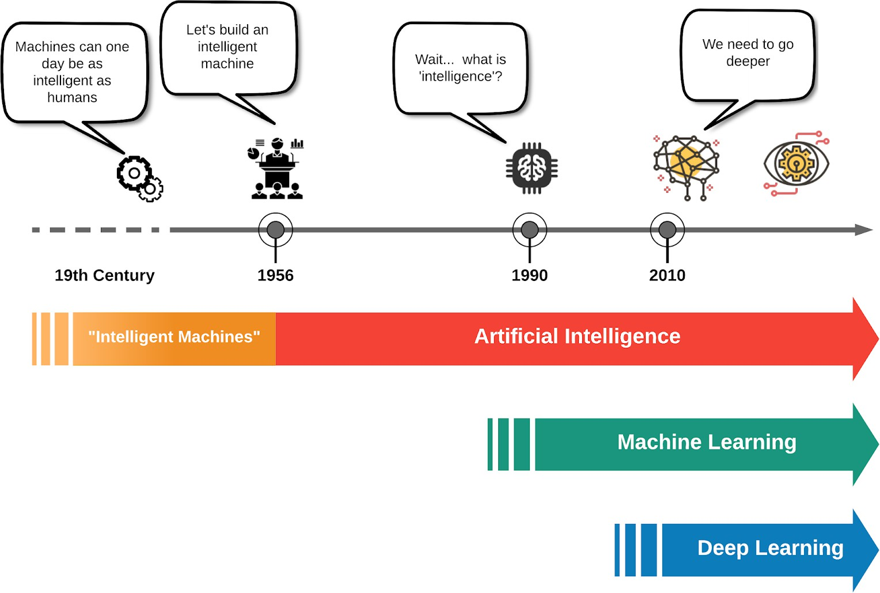
Courtesy: medium

Slide 14
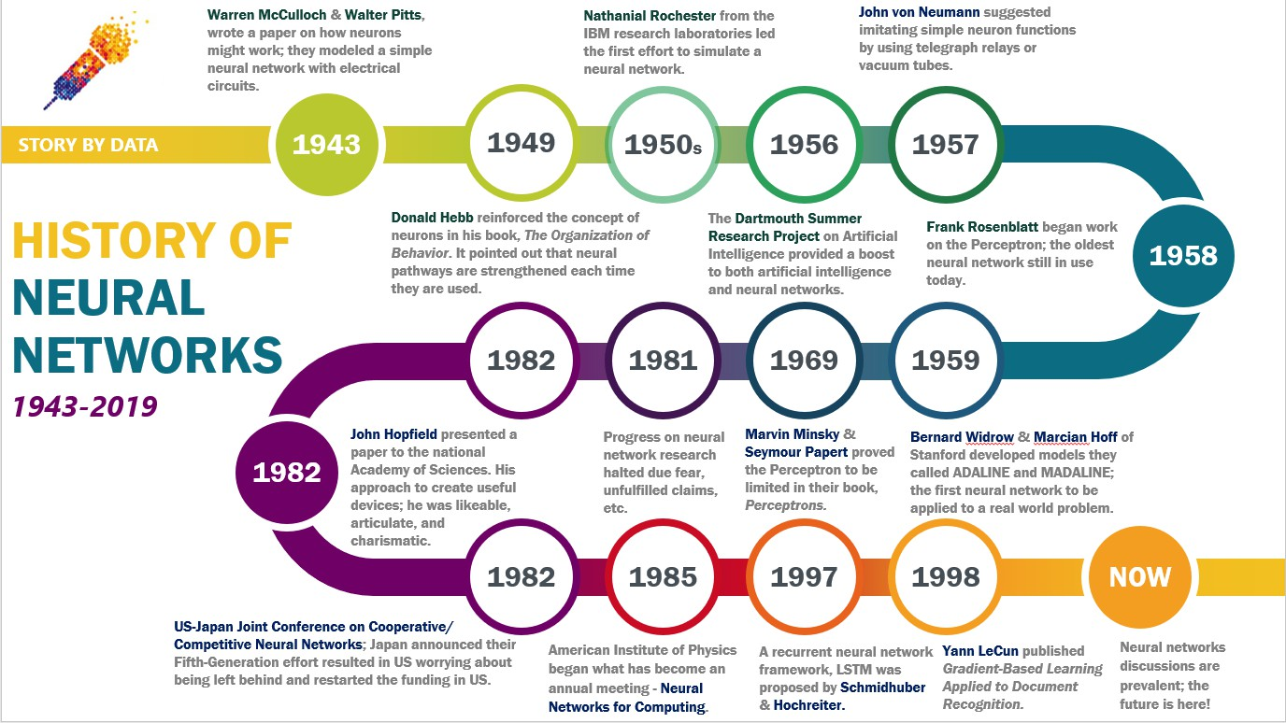
Courtesy: medium

Slide 15
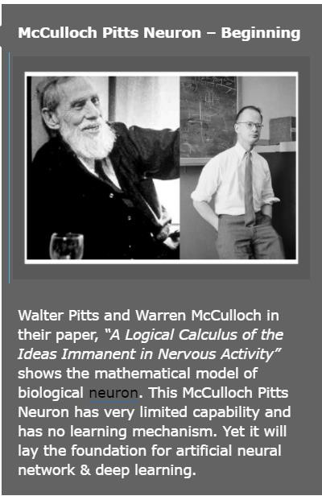
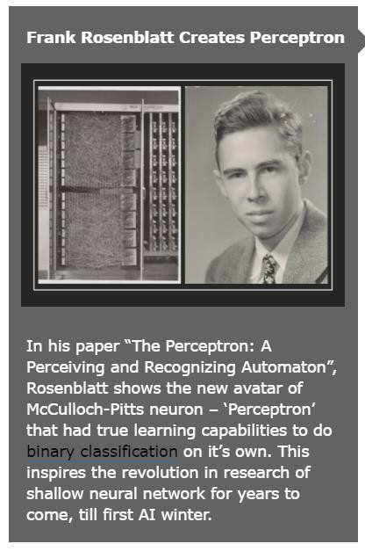
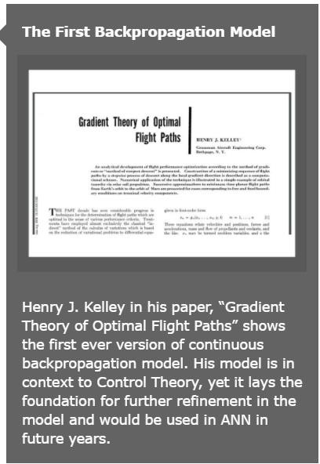
1943
1957
1960
Courtesy: machinelearningknowledge.ai

Slide 16
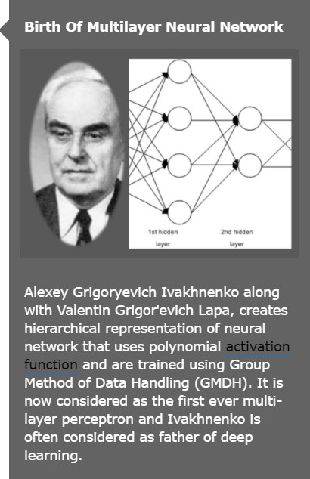
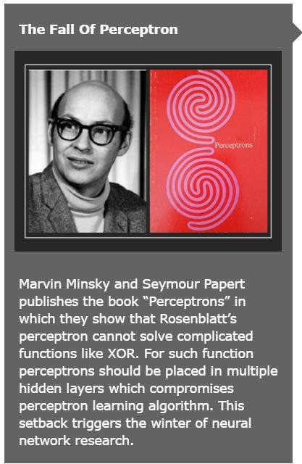
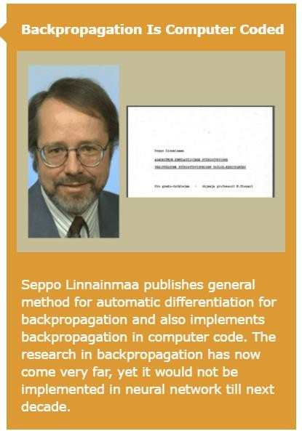
1965
1969
1970
Courtesy: machinelearningknowledge.ai

Slide 17
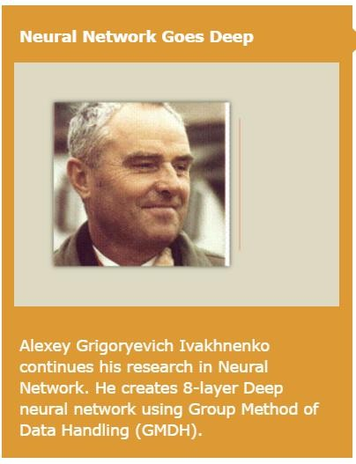
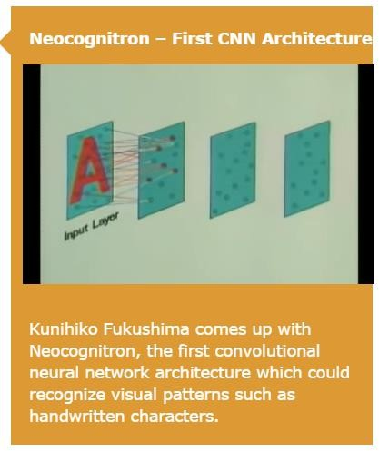
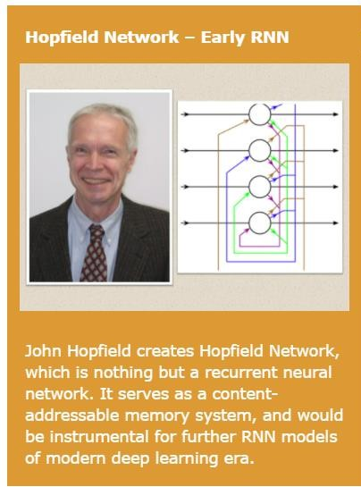
1970
1980
1982
Courtesy: machinelearningknowledge.ai

Slide 18
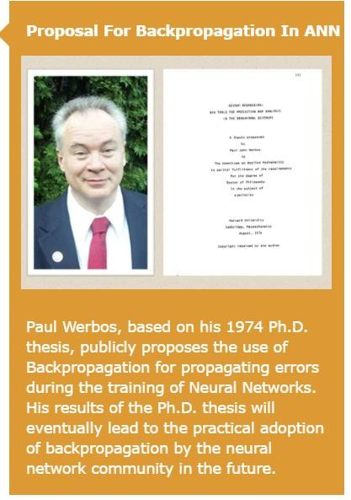
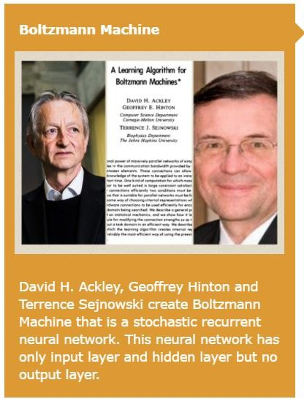
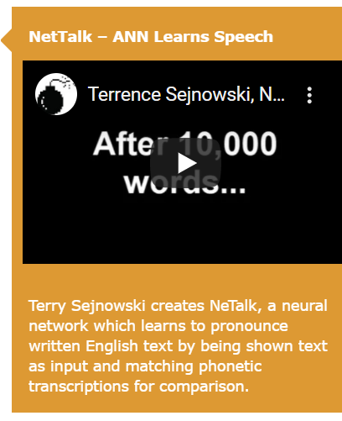
1985
1986
Courtesy: machinelearningknowledge.ai
1982

Slide 19
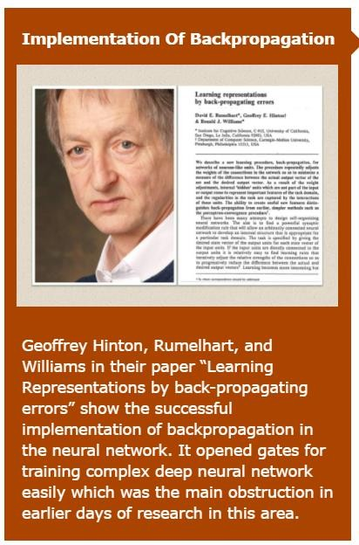
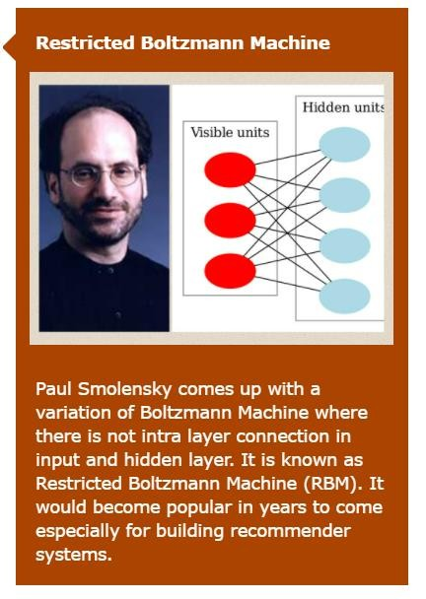
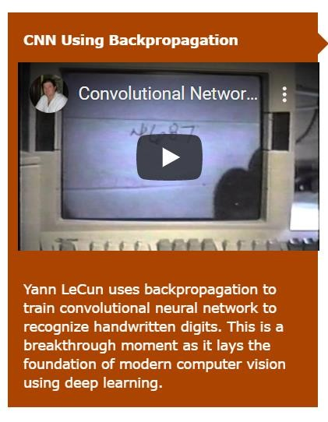
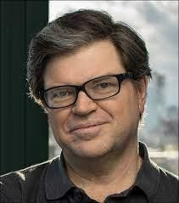
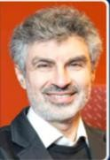
1986
1986
1989
Courtesy: machinelearningknowledge.ai

Slide 20
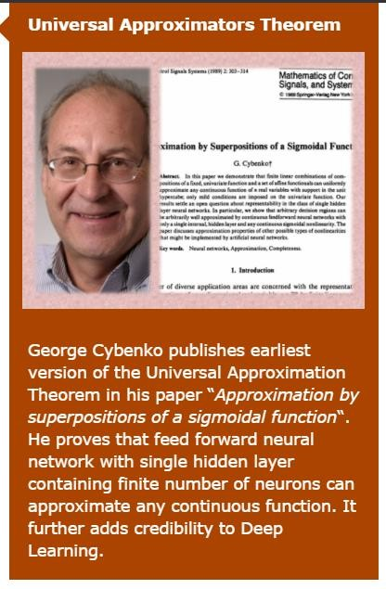
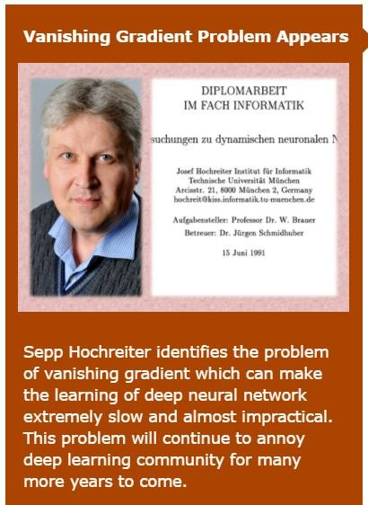
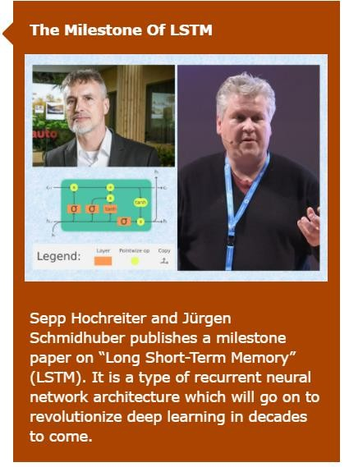
1989
1990
1997

Slide 21
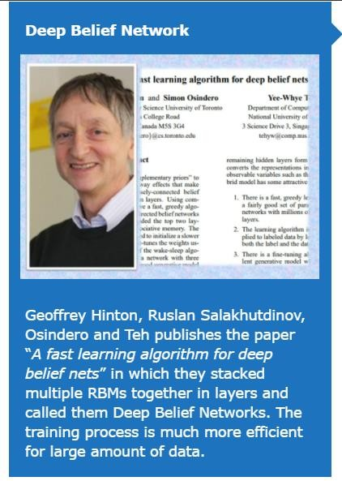
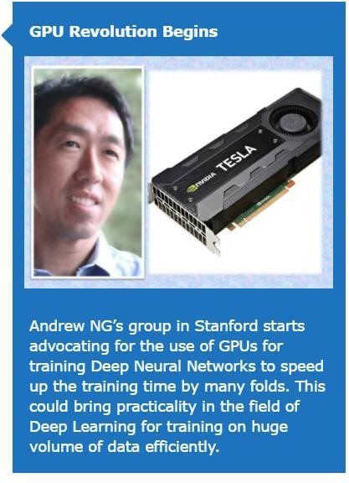
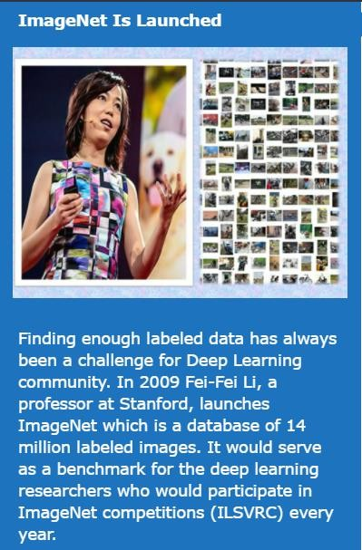
2006
2008
2010
Courtesy: machinelearningknowledge.ai

Slide 22
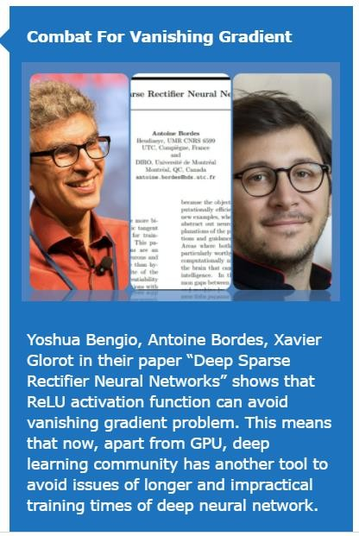
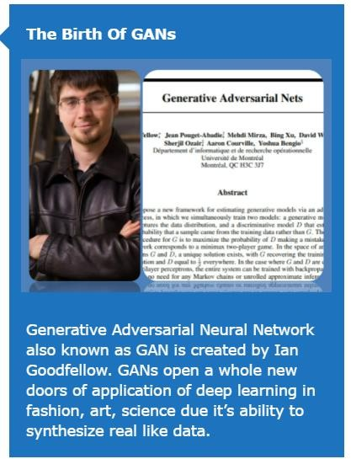
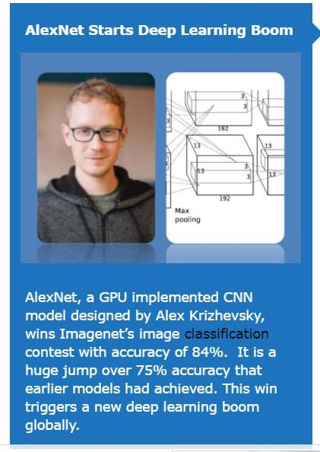
2012
2014
2011

Slide 23
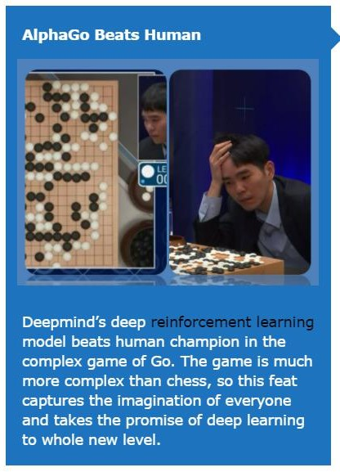
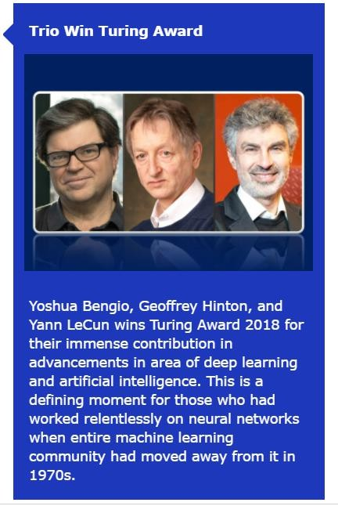
Geoffrey Hinton
long known as the "Godfather of
Deep Learning“
Was a Google researcher and left by 2023.
2016
2019
Courtesy: machinelearningknowledge.ai

Slide 24
Deep Learning Models ( Big Picture)
Sequential Models
RNN
LSTM
Encoder – Decoder models
Attention mechanism
Transformers
BERT
Transformers, Transformer-XL, Masked Language Modelling
Generative Pre-trained Transformer 3 (GPT-
3)
Autoencoders,Autoregressive models
Time series forecasting
NADE, MADE(Masked Autoencoder Density
Estimator), PixelRNN
Graph Neural Networks
Deep Neural Networks
MP Neuron, Perceptron
Neural Networks ( MLP)
Deep Neural Networks/Feed forward Networks
Convolutional Neural Networks ( CNN)
LeNet
AlexNet
VGG
ResNet
GoogleNet
Object Detection models
RCNN
Yolo
Generative models
Generative Adversarial Networks,(GAN)

Slide 25
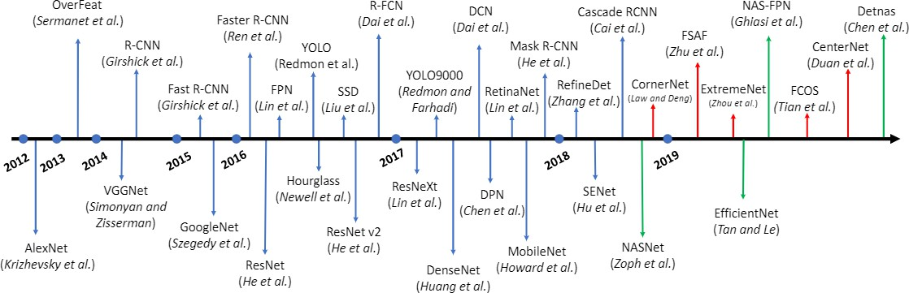
Evolution of Deep Learning Architectures

Slide 26
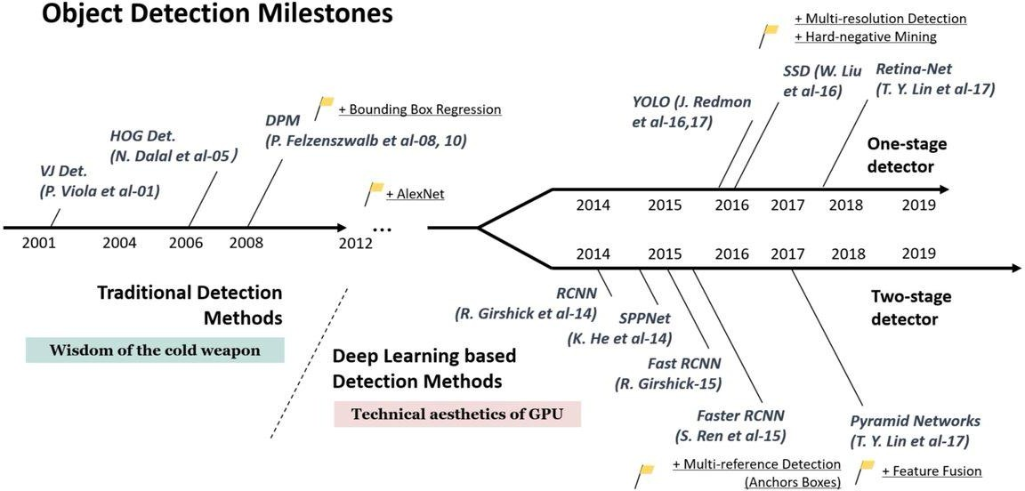

Slide 27
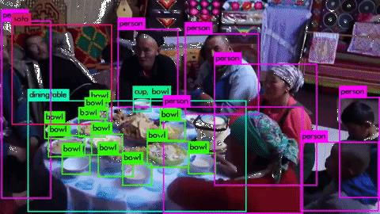
Object Detection
Deep Learning applications

Slide 28
Deep Learning Applications
Language
Modeling
Speech
Recognition
Machine
Translation
Machine
Transliteration
Conversational modelling
Time Series Forecasting.
Question Answering
Object Detection/ Recognition
Visual Tracking
Image Captioning
Video Captioning
Visual Question answering
Video Qs Answering
Video Summarisation
Generate data sets

